Slide 1
Group 4 Project #1 Members Tia Anderson-Ortega Josh Bond Janette Chairez Anthony Goins Krishna Pulipaka
Impact of COVID-19 on Texas Workforce

Slide 2
Analysis of Job Turnover and Separation due to COVID-19 by using Texas Labor Market Data, COVID Tracking Data and Bureau of Labor Statistics
United States and Texas Unemployment Rate Comparison by providing geospatial visualizations specifically delta change per County between July 2019 and July 2020
Texas Labor Market Analysis for Percent Women and Men COVID Positive Tests with a Line Graph over April 2020 to August 2020
Total claims for Houston between Jan 2019 to July 2020 with a Line Graph
Percent of Unemployment Rate by Men, Women and Teenagers with a Line Graph
Bar graph comparison of Positive Tests Per Month for Texas and New York
Comparing Industry by Industry Annual % Change of Unemployment Rate via Bar Graph
Statistical Analysis
PROJECT DESCRIPTION AND OUTLINE

Slide 3
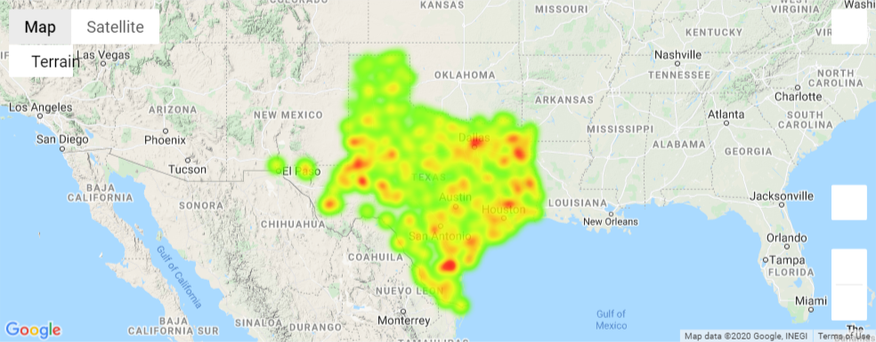
Geo Spatial for all Counties in Texas – Heatmap for % Change between Non-COVID time vs. COVID time

Slide 4
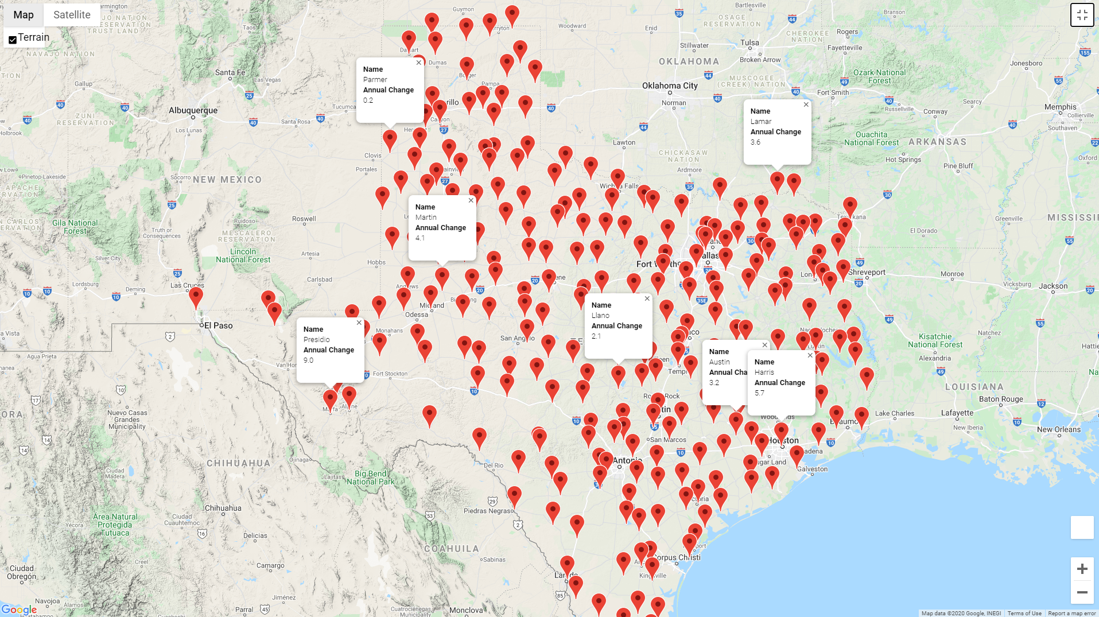
Geo Spatial Analysis of Texas Unemployment Rate by County

Slide 5
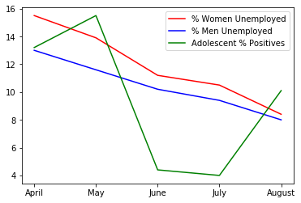
Comparison of Unemployment Rates Over time between Men and Women with COVID Positive Test Results

Slide 6
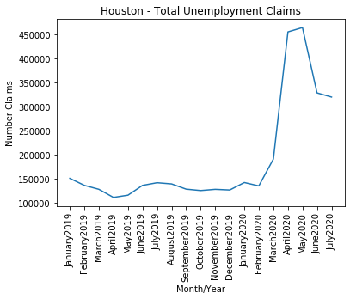
Total Unemployment Claims for all Houston Area

Slide 7
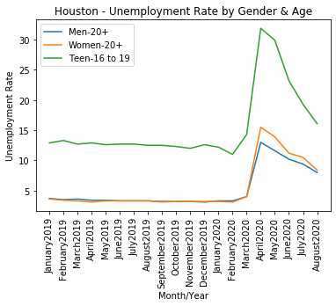
Analysis of Unemployment Rate
by
Age and Gender

Slide 8
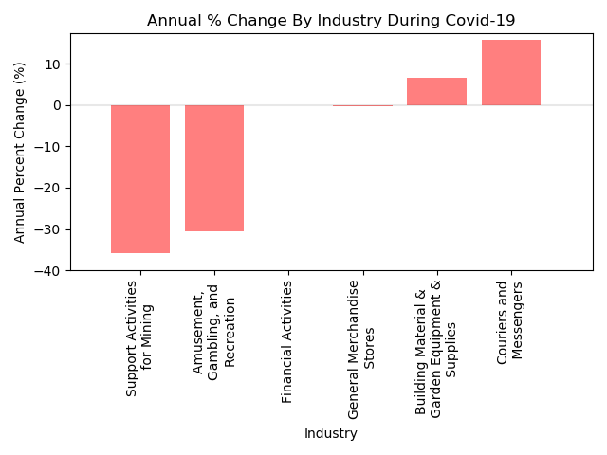
Annual Percent Change of Unemployment Rate By Industry

Slide 9
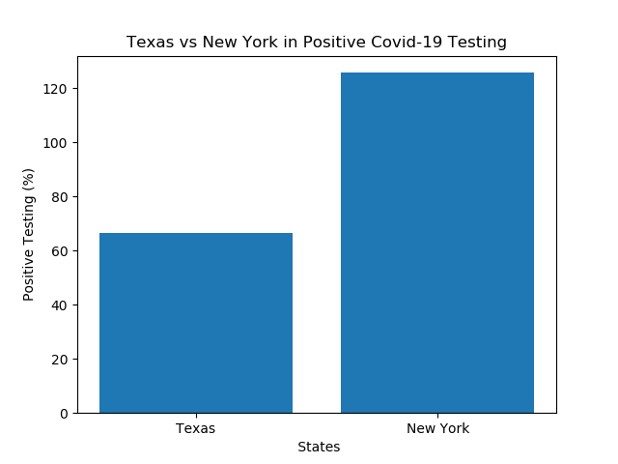
Comparison between Texas and New York positive testing

Slide 10
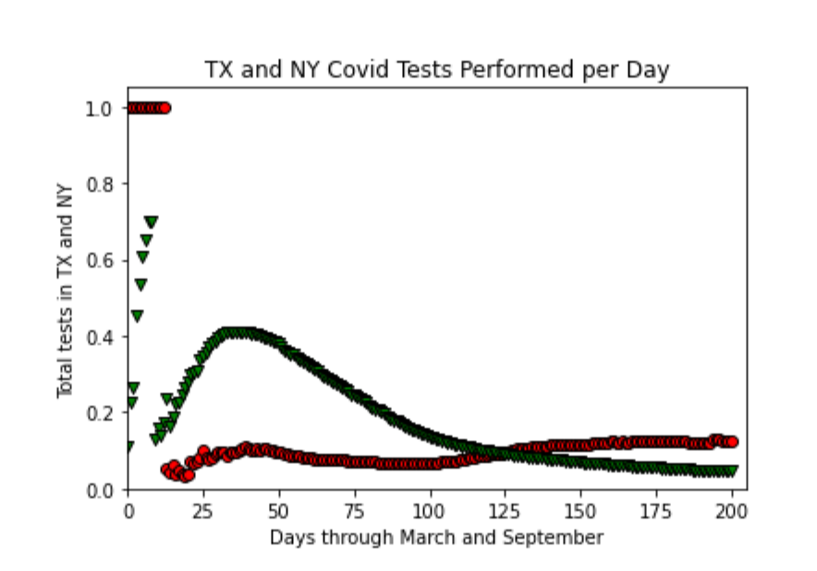
Texas and New York COVID Tests Performed Per Day

Slide 11
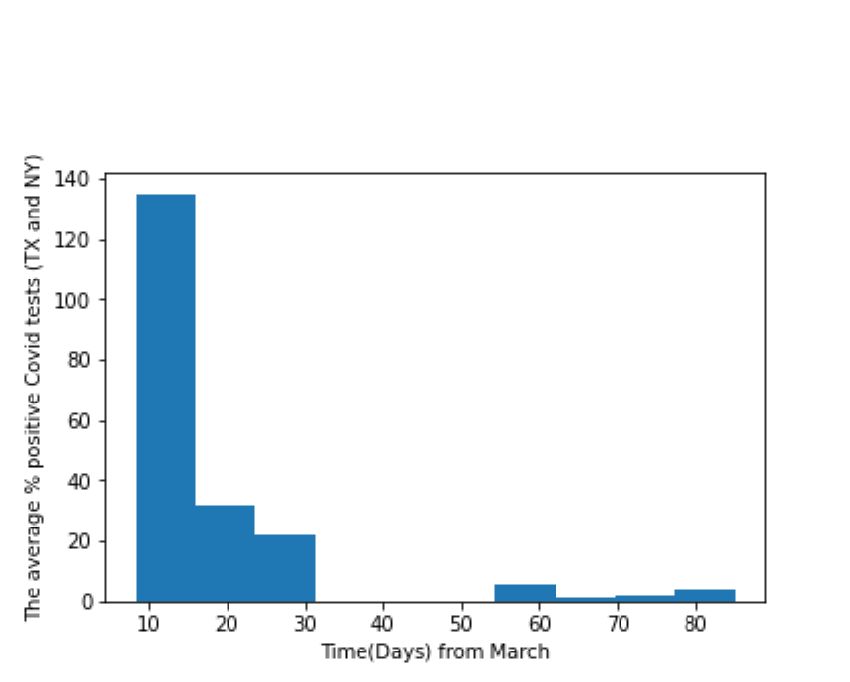
Texas and New York COVID Tests Performed Per Day

Slide 12
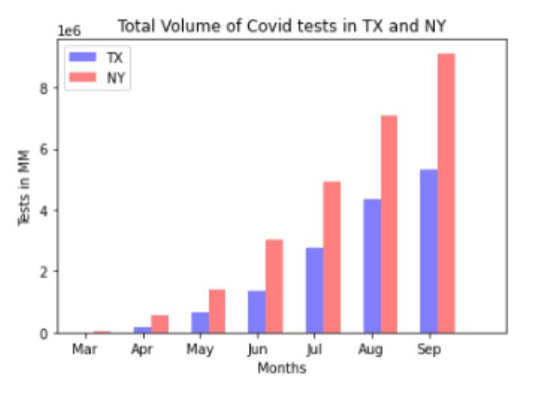
Texas and New York COVID Tests Performed Per Day

Slide 13
We assumed that there is a direct correlation between Unemployment Rates and Claims to COVID 19 cases across Counties in TX
We assumed that positive COVID 19 cases will go down as parents that were laid off stayed home but we proved that it is not the case
There were more women that were unemployed than men
The highest impacted age groups were teenagers between 16-19
We concluded that most industries were impacted both positively and negatively due to COVID-19
Couriers and Messengers industry has positive growth and support activities for Mining (suppliers, transportation and materials)
Conclusions

